Slide 1
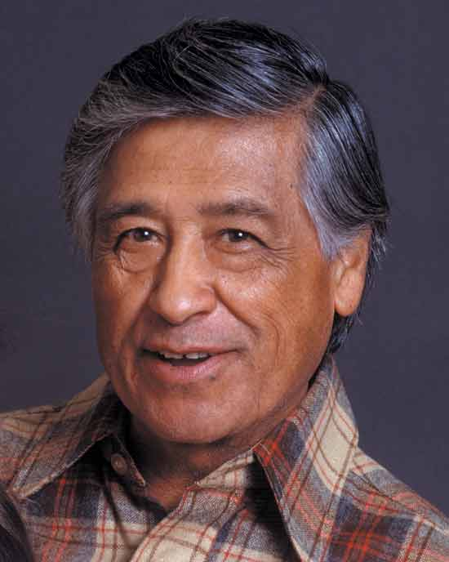
Stem-changing verbs in the present tense
This famous quote from
César Chávez uses a stem-
changing verb. Notice the O
from poder changes to UE.
“Sí se puede.”
César Chávez

Slide 2
Objective…talking about the present (stem-changing verbs)
A stem-changing verb means that there is a vowel change in some forms of the verb. These are also called “boot” or “shoe” verbs because the forms that make the vowel change make that form when conjugating the six subject pronouns.
In Spanish there are 3 main types of stem-changing verbs: “e-ie”, “o-ue” and “e-i”. There is one verb that changes “u-ue”.
There is never a vowel change in the nosotros nor vosotros forms in the present tense. A vowel changes inside only in the shoe or boot as shown in the slides that follow.

Slide 3
To be able to conjugate verbs, you must know your subject pronouns. Review them below.
Singular Plural
yo=I nosotros/nosotras =we
tú=you (familiar) vosotros/vosotras=you guys (informal in Spain)
él=he ellos-they (all guys/mixed)
ella=she ellas-they (girls)
usted (Ud.)-(you formal) ustedes (Uds.)=you all (formal in Spain)
*Vosotros(as) is only used in Spain.

Slide 4
Conjugation of stem-changing verbs
perder (ie)=to lose
First you need a stem-changing infintive.
To conjugate, take off the last 2 letters of the infinitive verb (the –ar, -er, or –ir ending). Now you have the stem or root of the verb.
Figure out what your subject is (who or what is doing the action).
If it is any subject, other than vosotros or nosotros, make the vowel change from “e” to “ie”, “o-ue” or “e-i”.
Finally, add the appropriate verb ending for the present tense to the verb. Remember there are different endings for –ar, -er and –ir verbs.
perd
Let’s say Manuel is the subject.
pierd
Manuel pierde.

Slide 5
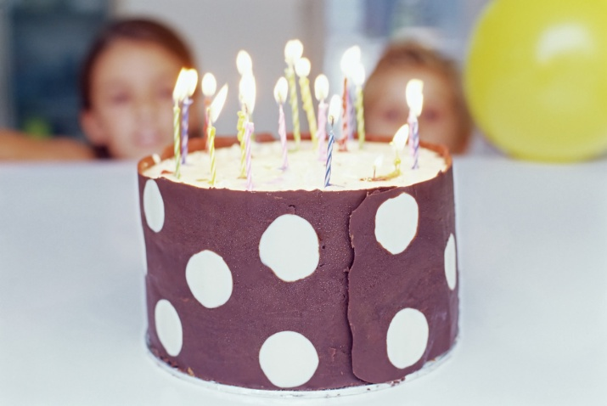
Objective…talking in the present (e-ie verbs)
“querer”-to want(e → ie)
quiero 1. queremos
quieres 2. queréis
quiere 3. quieren
OJO: The forms that make the vowel change make the form of a boot.

Slide 6
Objective…talking in the present (e-ie verbs)
“preferir”-to prefer (e → ie)
prefiero 1. preferimos
prefieres 2. preferís
prefiere 3. prefieren
This verb is often used in a double verb sentence where the first verb is conjugated and the second is left an infinitive verb.
Ejemplo…Ella prefiere leer. (She prefers to read.)

Slide 7
Objective…talking in the present (e-ie verbs)
“empezar” and “comenzar”-to start, begin (e → ie)
empiezo 1. empezamos
empiezas 2. empezáis
empieza 3. empiezan

Slide 8
Objective…talking about the present (stem-changing verbs O-UE)
almorzar (o→ ue) – to eat lunch
almuerzo 1. almorzamos
almuerzas 2. almorzáis
almuerza 3. almuerzan

Slide 9
Objective…talking about the present (stem-changing verbs O-UE)
encontrar (o→ ue) – to find
encuentro 1. encontramos
encuentras 2. encontráis
encuentra 3. encuentran

Slide 10
Objective…talking about the present (stem-changing verbs O-UE)
dormir (o→ ue) – to sleep
duermo 1. dormimos
duermes 2. dormís
duerme 3. duermen

Slide 11
Objective…talking about the present (stem-changing verbs O-UE)
poder (o→ ue) – to be able
puedo 1. podemos
puedes 2. podéis
puede 3. pueden
This verb is often used in a double verb sentence where the first verb is conjugated and the second is left an infinitive verb.
Ejemplo…Uds. pueden ir a la fiesta.
(You all can go to the party.)

Slide 12
Objective…talking about the present (stem-changing verbs u-ue)
“jugar” is slightly irregular
Jugar is a shoe verb, boot verb or a stem-changing verb. The vowel changes inside only in the shoe.
Jugar (u → ue)-to play (game or sport)
Juego 1. Jugamos
Juegas 2. Jugáis
Juega 3. Juegan

Slide 13
Objective…talking about the present (stem-changing verbs E-I)
stem-changing verbs
repetir-to repeat (e→ i)
repito repetimos
repites repetís
repite repiten

Slide 14

Objective…talking about the present (stem-changing verbs E-I)
stem-changing verbs
pedir-to ask for (e→ i)
pido pedimos
pides pedís
pide piden

Slide 15
Objective…talking about the present (stem-changing verbs E-I)
stem-changing verbs
servir-to serve (e→ i)
sirvo servimos
sirves servís
sirve sirven

Slide 16
Objective…talking about the present (stem-changing verbs E-I)
stem-changing verbs (e→ i)
vestirse-to dress oneself (to get dressed)
me visto nos vestimos
te vistes os vestís
se viste se visten
This is a reflexive action because he is dressing himself.
Notice the reflexive pronouns before the conjugated verb.

Slide 17
Objective…talking about the present (stem-changing verbs)
What is the correct present tense conjugation for the verbs that follow?

Slide 18
Objective…talking about the present (stem-changing verbs)
Ella ________ (servir) la comida hoy.
sirve

Slide 19
Objective…talking about the present (stem-changing verbs)
Nosotros _____ (almorzar) a las doce.
almorzamos
(no stem-change in the nosotros form)

Slide 20

Objective…talking about the present (stem-changing verbs)
Tú _________ (tener) que hacer la tarea todos los días.
tienes

Slide 21
Objective…talking about the present (stem-changing verbs)
¿________ (Poder) yo ir a la fiesta?
Puedo

Slide 22
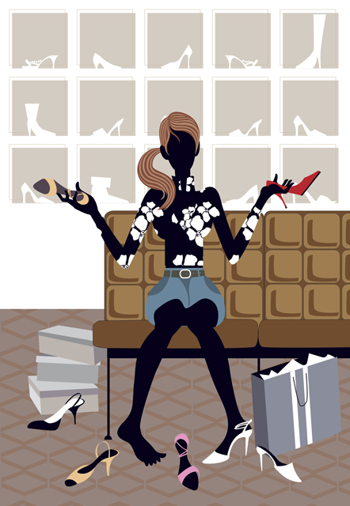
Objective…talking about the present (stem-changing verbs)
Ella ________ (preferir) ir de compras.
prefiere

Slide 23
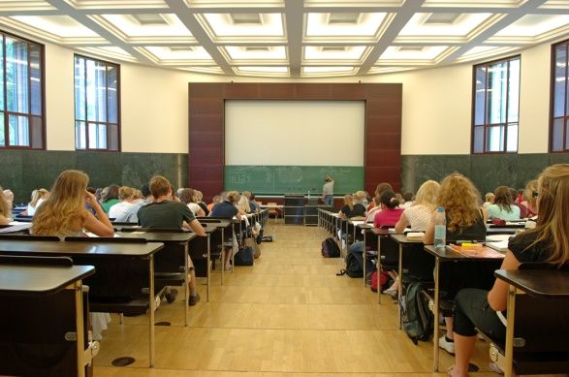
Objective…talking about the present (stem-changing verbs)
Ellas ________ (repetir) el vocabulario en español.
repiten

Slide 24
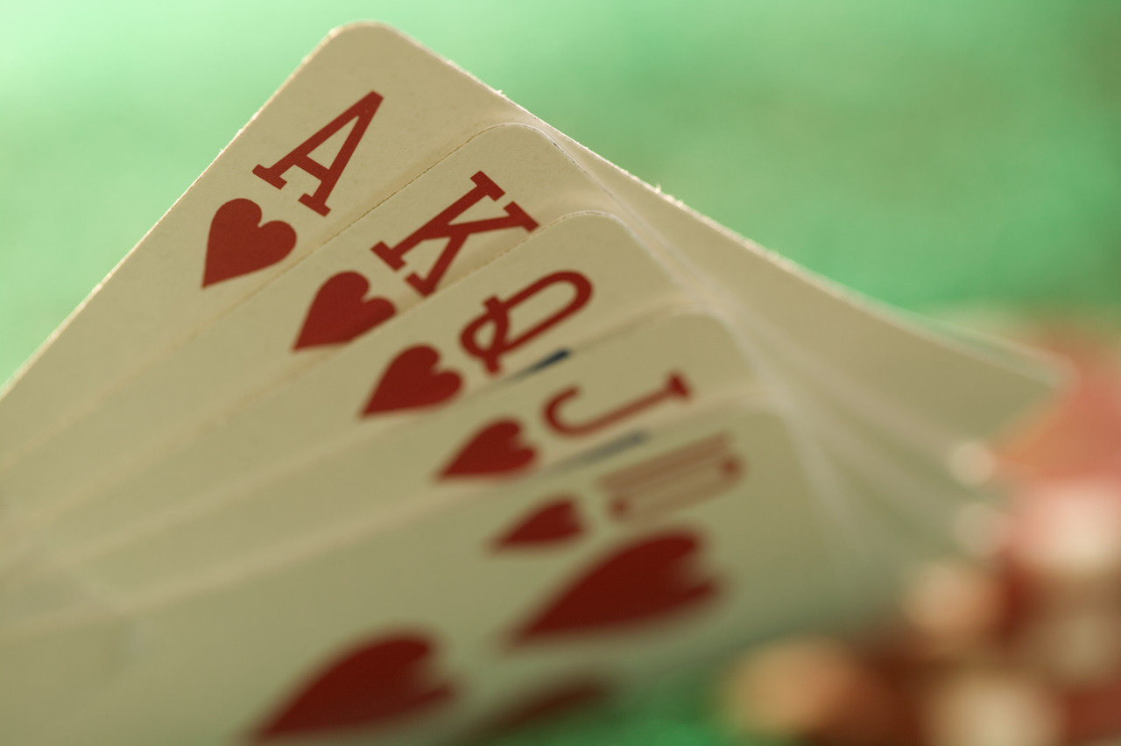
Objective…talking about the present (stem-changing verbs)
Usted ______ (jugar) a las cartas los sábados por la noche.
juega

Slide 25
Objective…talking about the present (stem-changing verbs)
Mi hija ___________ (dormir) ocho horas cada noche.
duerme

Slide 26

El fin
¡gol!

